Slide 1
Content-driven Newsfeed
A personalized editor with newsfeed

Slide 2
Objective:
Building a web (or mobile) editor similar to that of Google Doc where user can keep taking notes related to computer science & engineering, and also attach "related" news updates from Google News, Wire, TechCrunch and other related sources.
Solution:
A customized editor that analyzes text from user’s notes, fetches related news content using rest services.

Slide 3
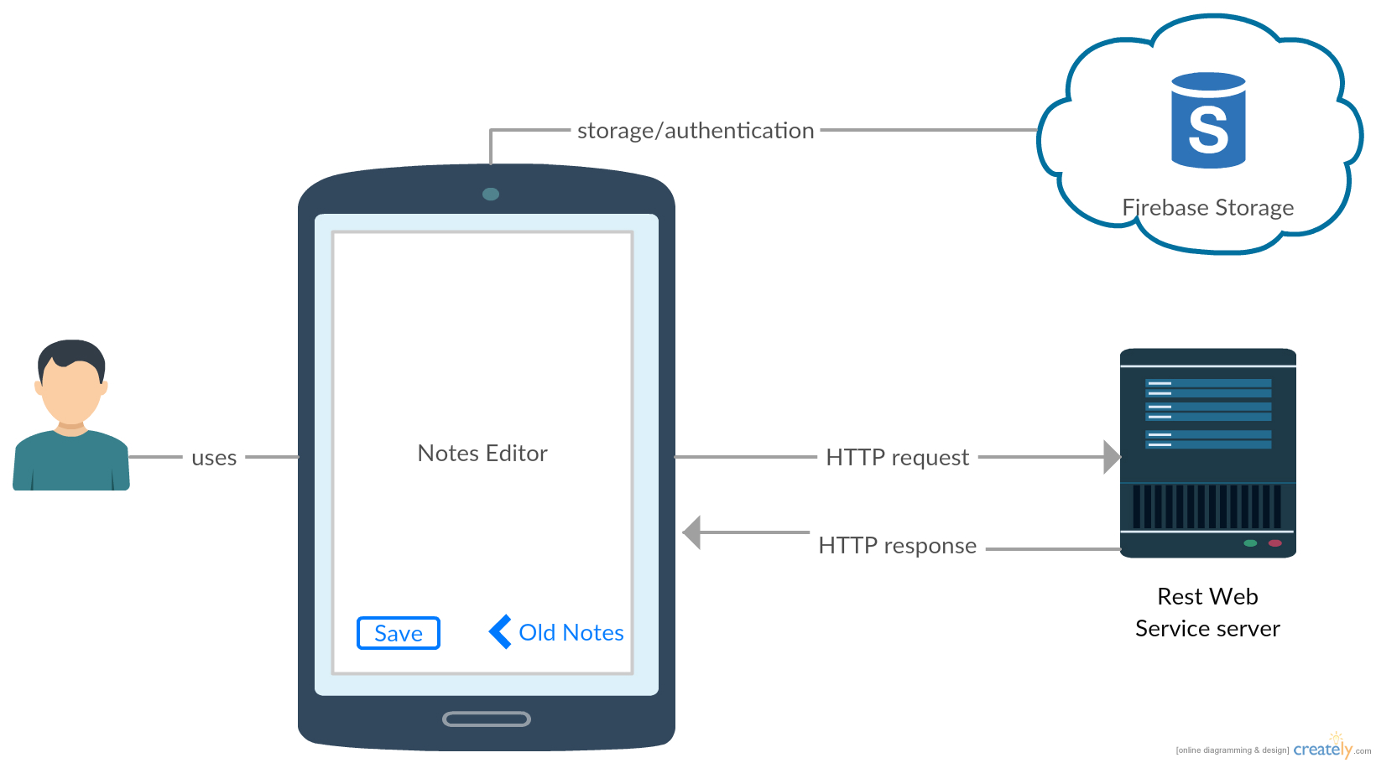
Architecture Design

Slide 4
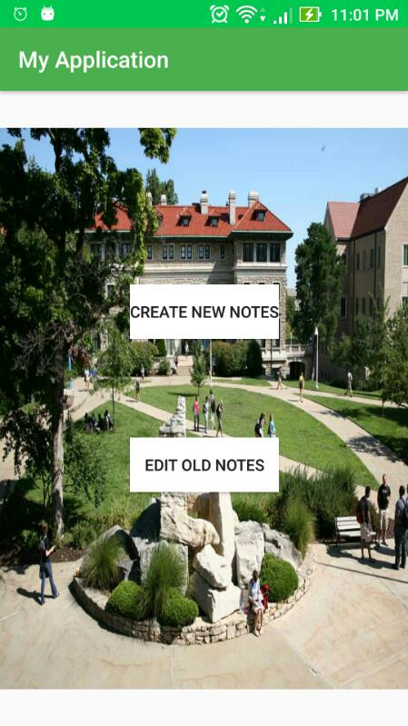
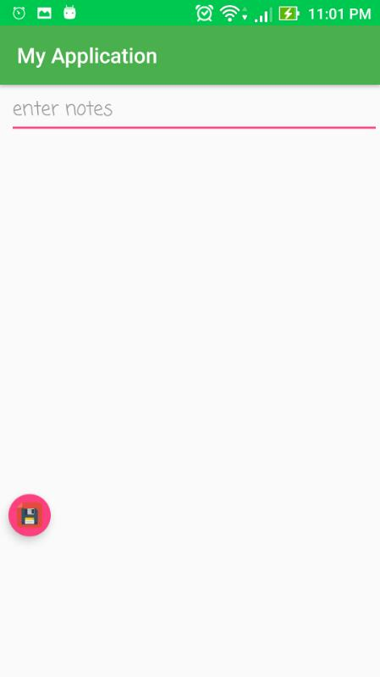
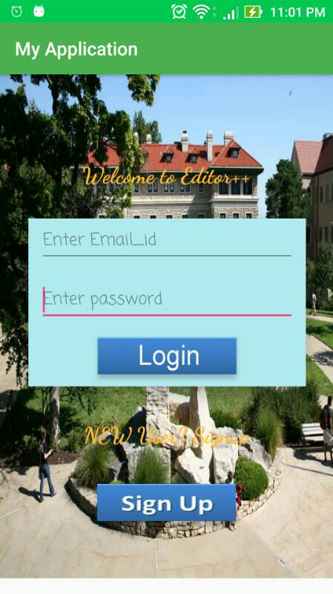
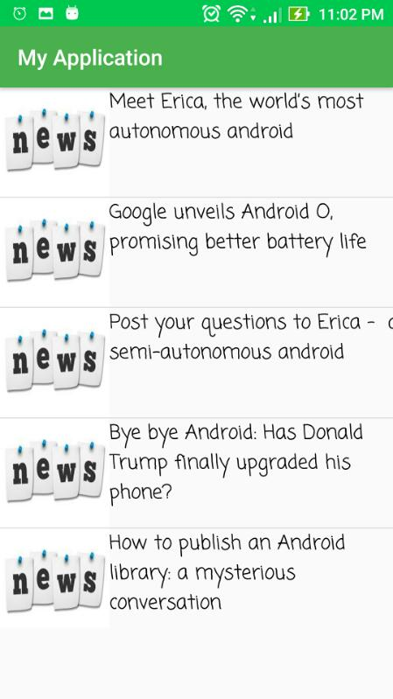
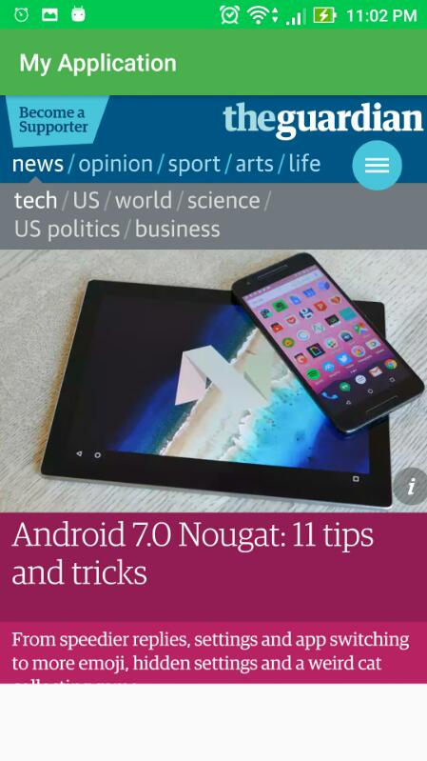
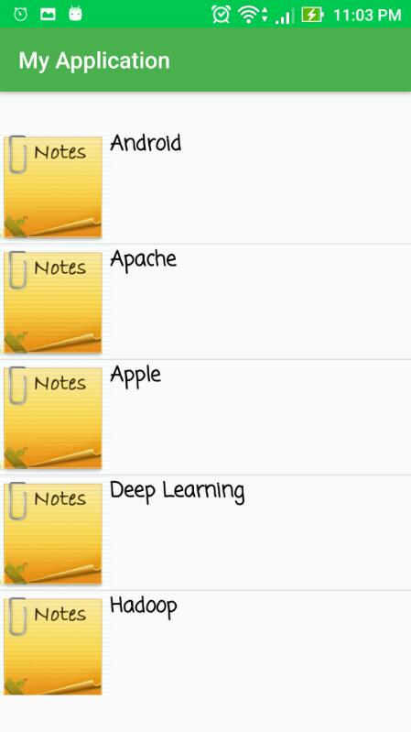
Application Life Cycle

Slide 5
Approach: This Android app keeps users engaged and updated with latest news of his notes from news providers like Guardian etc.

